Slide 1






Sales Forecasting and Optimization
Predict future sales to optimize inventory, marketing, and strategies.
For Cars Sales Dataset
For Full Project At:
GitHub
Make by:
Youssef Bassiony

Slide 2

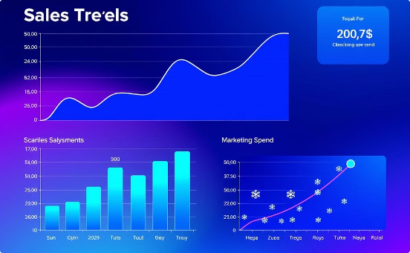

Milestone 1: Data Collection & Preprocessing
Collect historical sales data with features like promotions, holidays, weather.
Explore data trends, seasonality, and handle missing values.
Preprocess data: clean, engineer time features, scale for modeling.
Deliverables
Data Exploration Report
EDA Notebook with visualizations
Cleaned Dataset

Slide 3
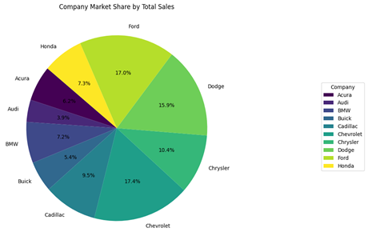
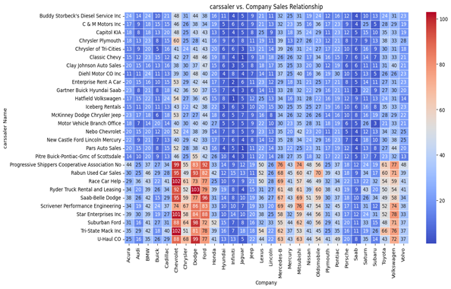

Slide 4
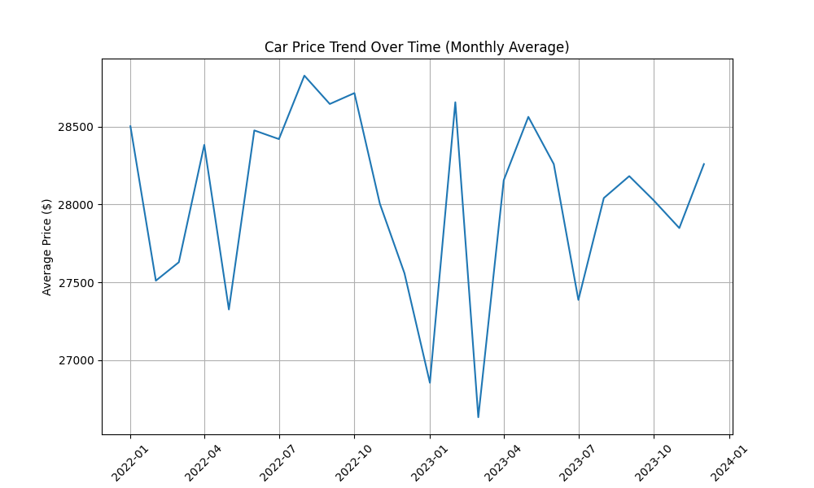
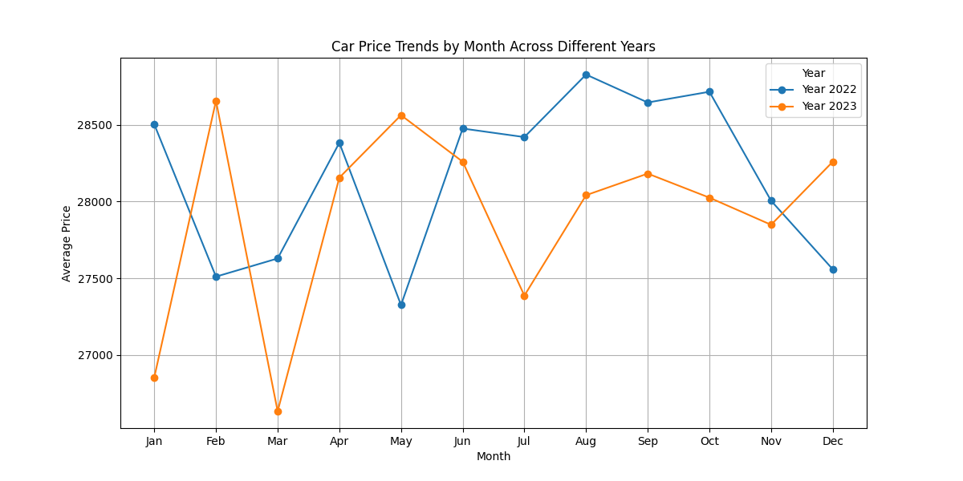

Slide 5
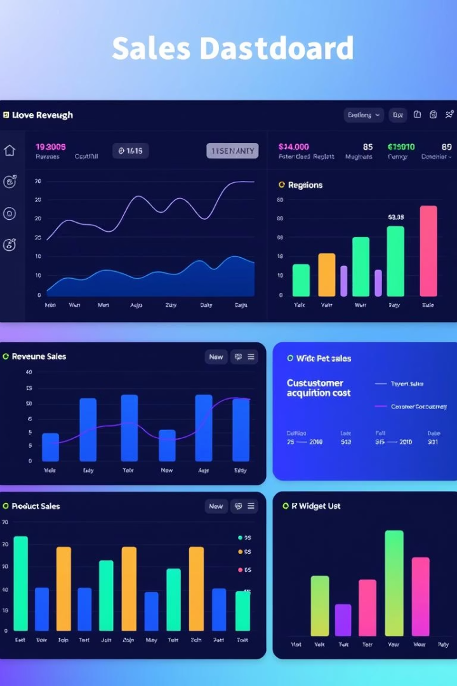
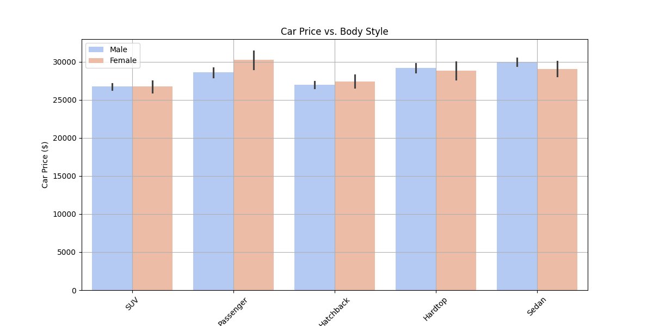
Milestone 2: Data Analysis & Visualization
Data Cleaning
Data Analysis
Address missing values, outliers, and inconsistencies.
Identify correlations with promotions, weather, holidays, trends.
Visualization
Create line graphs, bar charts, scatter plots, interactive dashboards and create Power Bi .

Slide 6
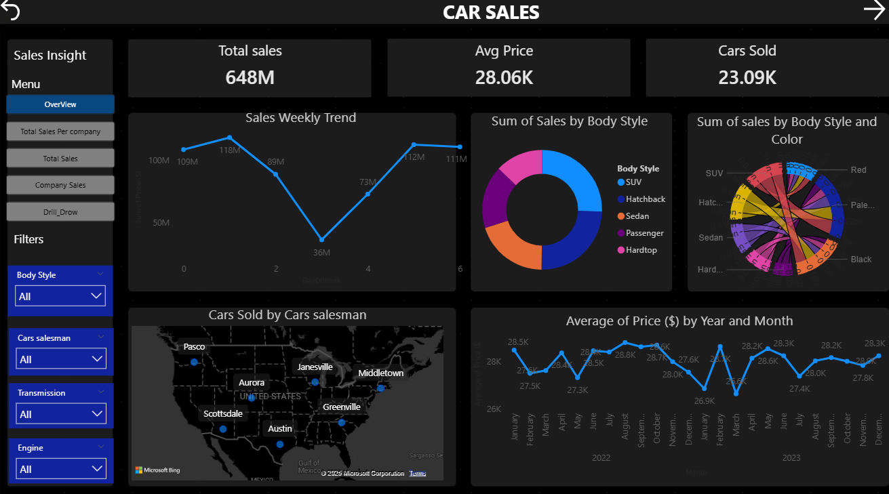
The Power Bi for Date to Explore the features
Overview Page

Slide 7
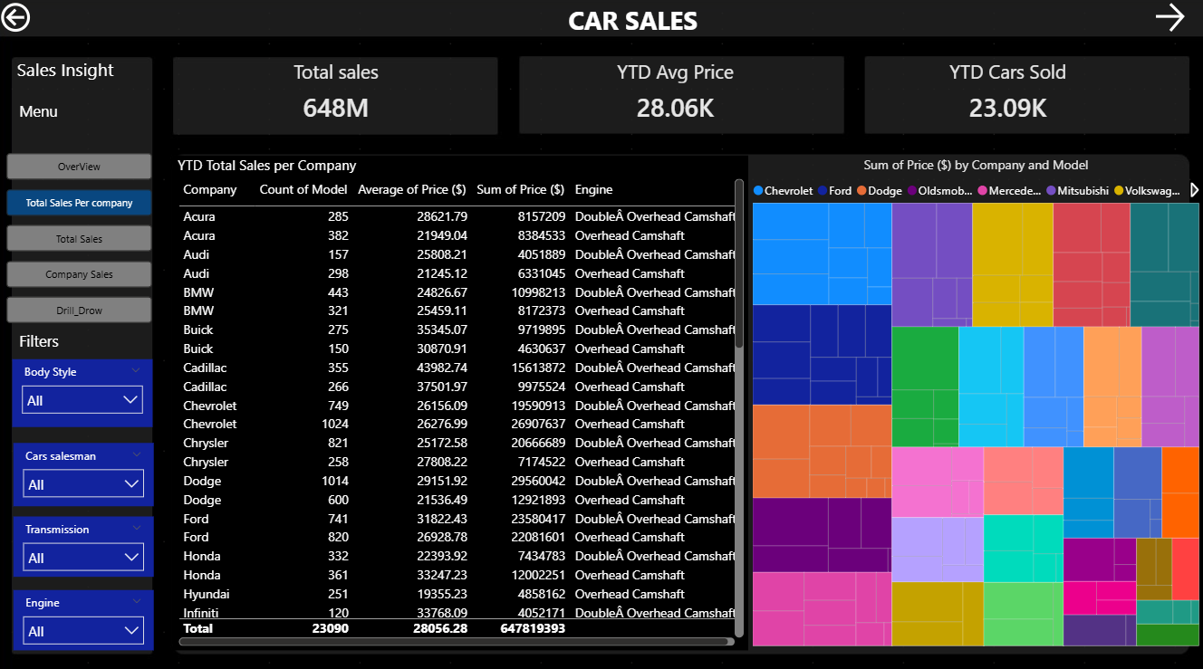
The Power Bi for Date to Explore the features
Total Sales Per Company Page

Slide 8
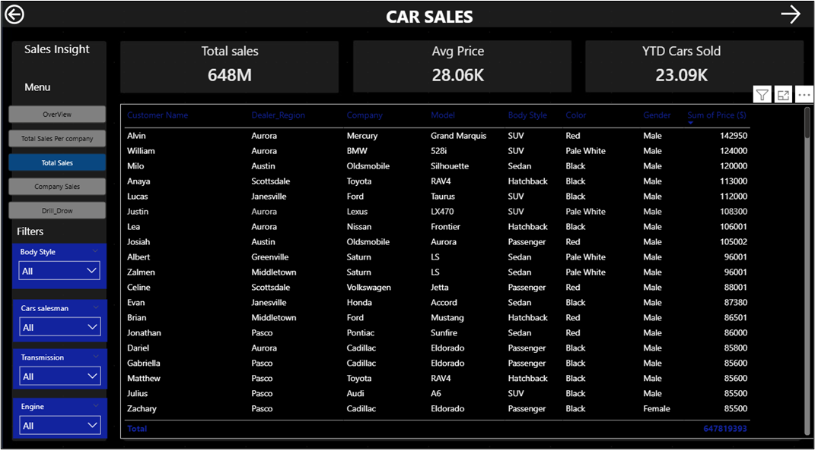
The Power Bi for Date to Explore the features
Total Sales Page

Slide 9
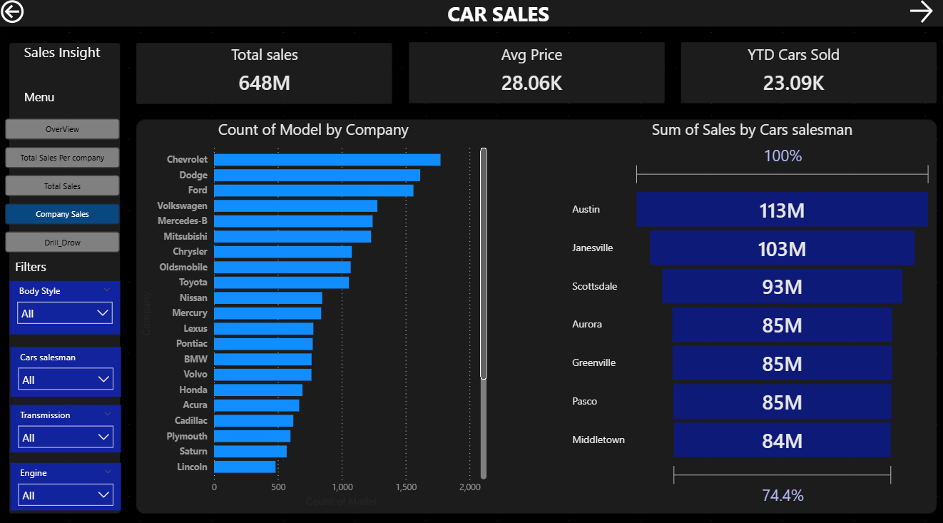
The Power Bi for Date to Explore the features
Company Sales Page

Slide 10
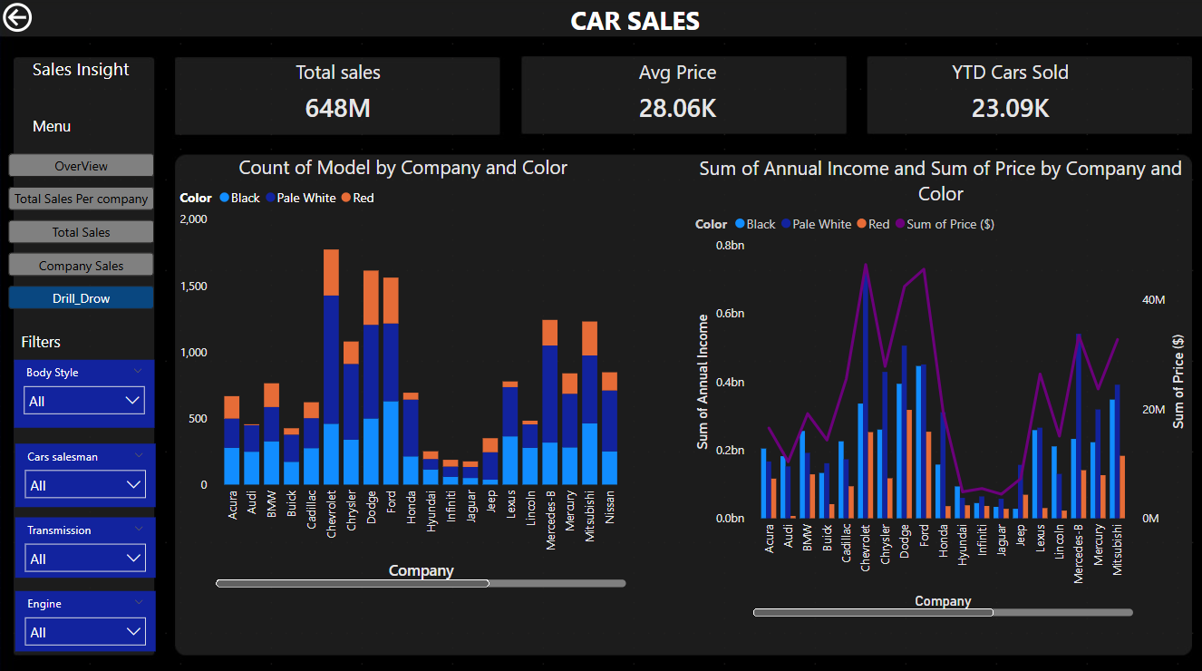
The Power Bi for Date to Explore the features
Drill Draw Page

Slide 11
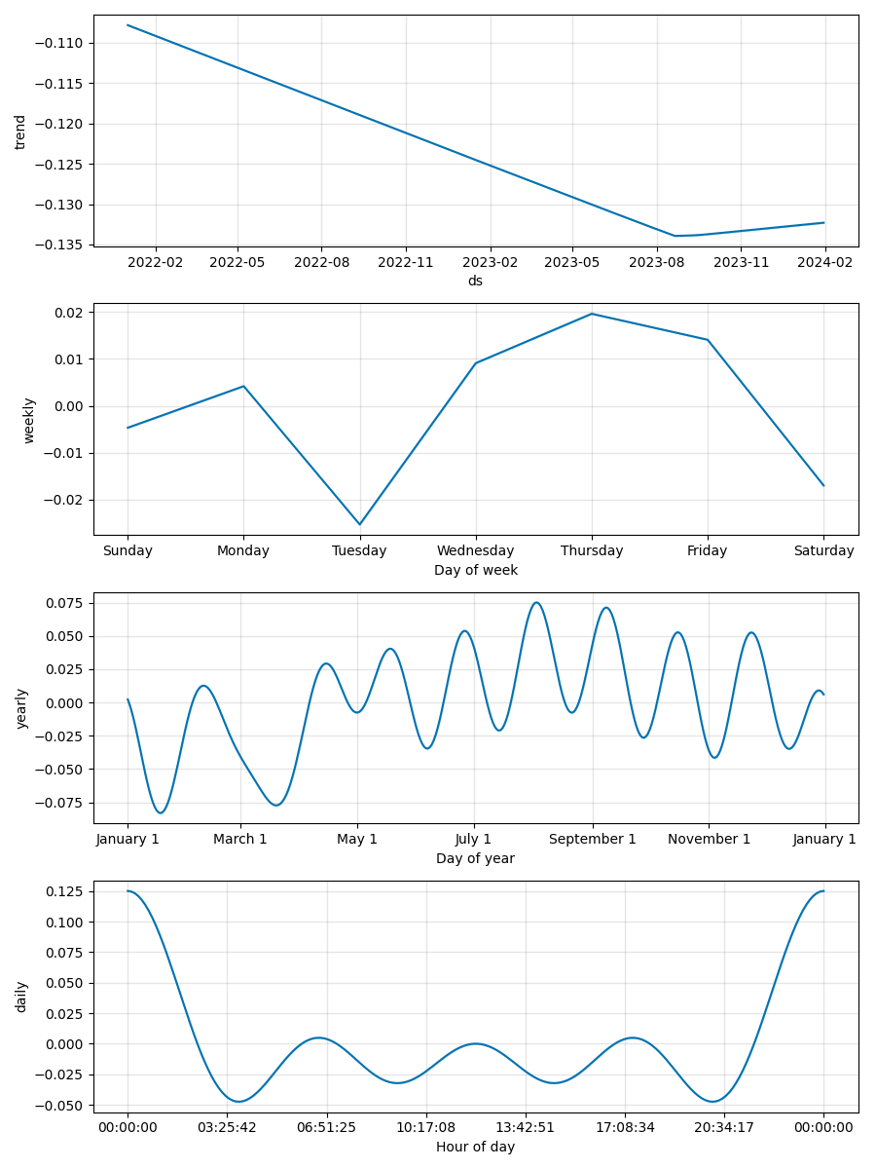
Milestone 3: Forecasting Model Development
Model Selection
Training & Evaluation
Choose ARIMA, SARIMA,
Prophet, xgboost.
Use time-series validation; evaluate with RMSE, MAE, MAPE.
Optimization
Tune hyperparameters; analyze residuals for model accuracy.

Slide 12

Milestone 4: MLOps, Deployment & Monitoring
MLOps Implementation
Track experiments, manage versions with MLflow and DVC.
Deployment
Deploy model via Streamlit for real-time or batch use.
Monitoring
Track model performance, detect drift, and enable feedback loops.
Performance Reporting
Log metrics and alert stakeholders on accuracy drops.

Slide 13


Milestone 5: Final Documentation & Presentation
Final Report
Presentation
Summarize data exploration, modeling, deployment, and insights.
Showcase model functionality, business value, and future use cases.
Challenges & Solutions
Highlight obstacles and how they were overcome.

Slide 14

Project Summary & Impact
Accurate Sales Predictions
Business Optimization
Leverage historical data for robust forecasting models.
Enhance inventory, marketing, and sales strategies.
Sustainable Deployment
Ensure model is deployable and maintainable long-term.

Slide 15





Next Steps & Future Opportunities
Continuous Improvement
Refine models with new data and feedback loops.
Expand Features
Incorporate more external factors and advanced algorithms.
Scalable Deployment
Broaden cloud deployment for higher availability.
User Training
Educate stakeholders on model use and interpretation.

Slide 16




Thank You!

